Slide 1
Conservation of Energy
Chapter One
Section 1.3

Slide 2
Alternative Formulations
CONSERVATION OF ENERGY
(FIRST LAW OF THERMODYNAMICS)
An important tool in heat transfer analysis, often
providing the basis for determining the temperature
of a system.
Alternative Formulations
Time Basis:
At an instant
or
Over a time interval
Type of System:
Control volume
Control surface

Slide 3
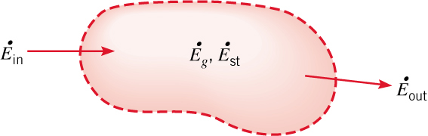



CV at an Instant and over a Time Interval
APPLICATION TO A CONTROL VOLUME
At an Instant of Time:
Note representation of system by a
control surface (dashed line) at the boundaries.
Surface Phenomena
Volumetric Phenomena
Conservation of Energy
(1.11a)
Each term has units of J/s or W.
Over a Time Interval
(1.11b)
Each term has units of J.

Slide 4
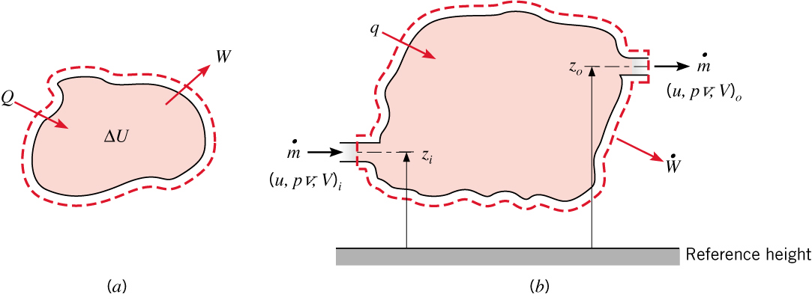
Closed System
Special Cases (Linkages to Thermodynamics)
  Transient Process for a Closed System of Mass (M) Assuming Heat Transfer
  to the System (Inflow) and Work Done by the System (Outflow).
Over a time interval
(1.11c)
At an instant
(1.11d)

Slide 5
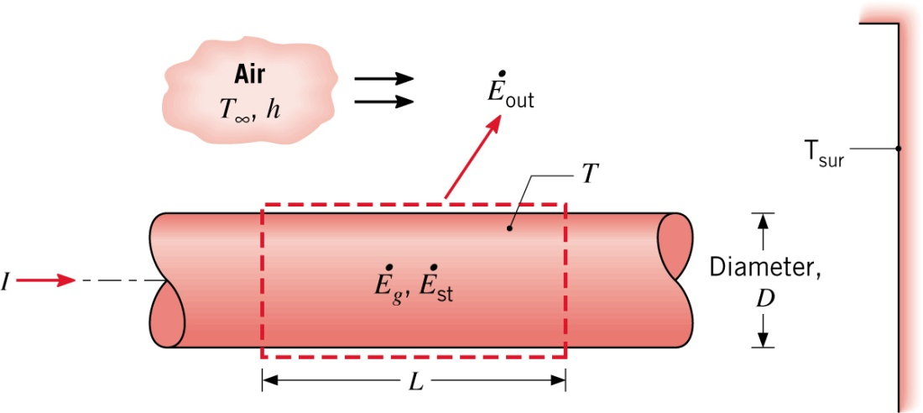
Example 1.3
Example 1.3: Application to thermal response of a conductor with Ohmic
heating (generation):
Involves change in thermal energy and for an incompressible substance.
Heat transfer is from the conductor (negative )
Generation may be viewed as electrical work done on the system (negative )

Slide 6
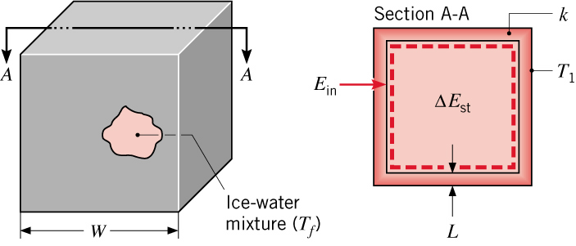
Example 1.4
Example 1.4: Application to isothermal solid-liquid phase change in a container:
Latent Heat
of Fusion

Slide 7



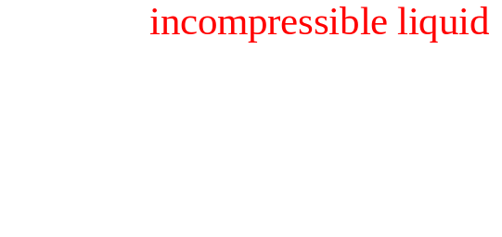
Open System
Steady State for Flow through an Open System without Phase Change or Generation:
At an Instant of Time:
(1.11e)

Slide 8
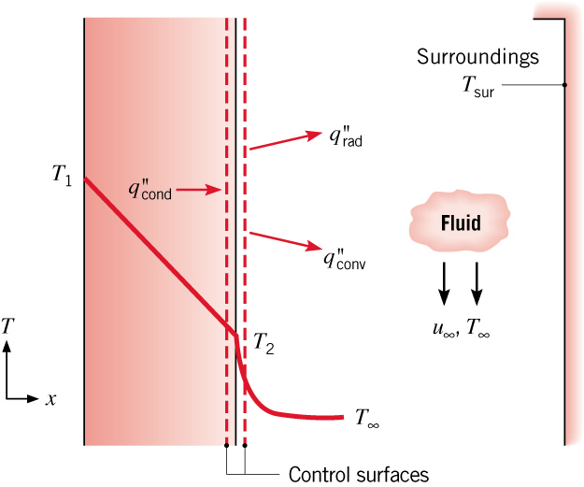
Surface Energy Balance
THE SURFACE ENERGY BALANCE
A special case for which no volume or mass is encompassed by the control surface.
Conservation Energy (Instant in Time):
(1.12)
Applies for steady-state and transient conditions
With no mass and volume, energy storage and generation are not pertinent to the energy
balance, even if they occur in the medium bounded by the surface.
Consider surface of wall with heat transfer by conduction, convection and radiation.

Slide 9
Methodology
METHODOLOGY OF FIRST LAW ANALYSIS
On a schematic of the system, represent the control surface by
dashed line(s).
Choose the appropriate time basis.
Identify relevant energy transport, generation and/or storage terms
by labeled arrows on the schematic.
Write the governing form of the Conservation of Energy requirement.
Substitute appropriate expressions for terms of the energy equation.
Solve for the unknown quantity.

Slide 10
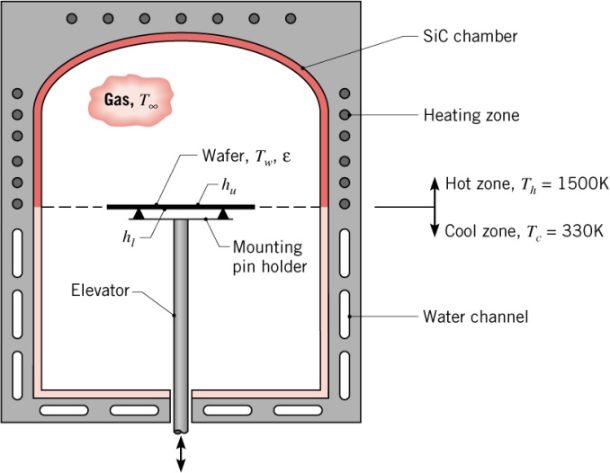
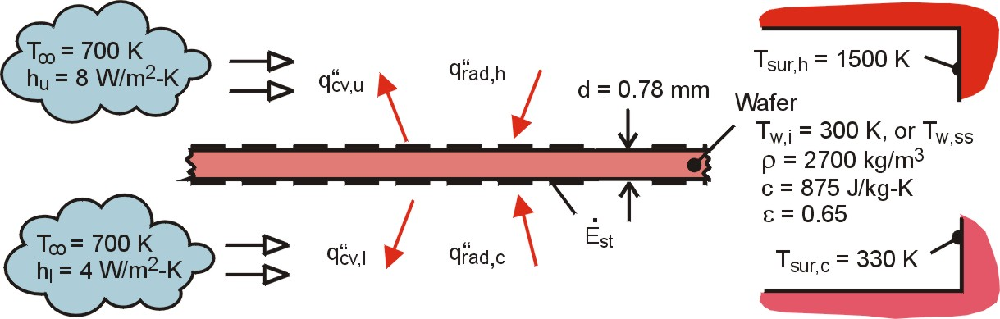
Problem: Silicon Wafer
Problem 1.43: Thermal processing of silicon wafers in a two-zone furnace.
Determine (a) the initial rate of change of the wafer
temperature and (b) the steady-state temperature.
SCHEMATIC

Slide 11
Problem: Silicon Wafer (cont.)
or, per unit surface area

Slide 12
Problem: Silicon Wafer (cont.)

Slide 13
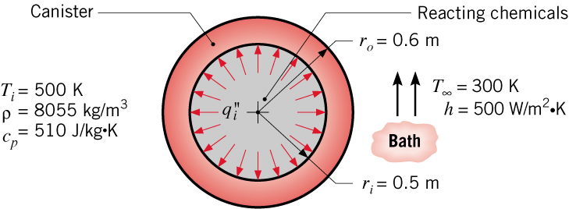
Problem Cooling of Spherical Canister
Problem 1.48: Cooling of spherical canister used to store reacting chemicals.
Determine (a) the initial rate of change of the canister temperature,
(b) the steady-state temperature, and (c) the effect of convection
on the steady-state temperature.

Slide 14
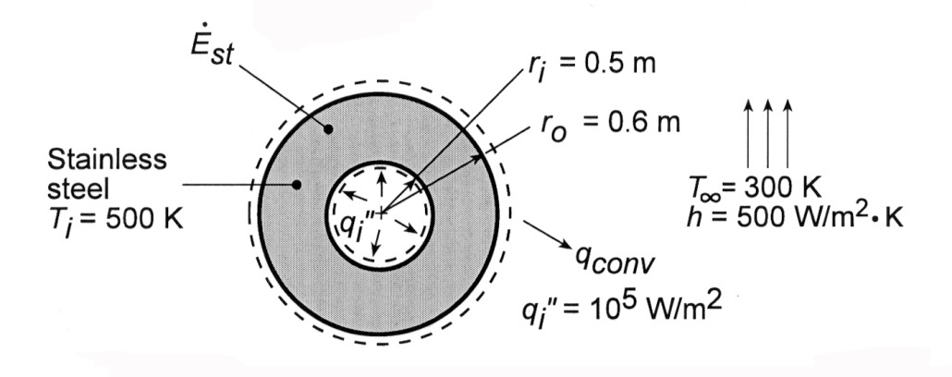

Problem Cooling of Spherical Canister
SCHEMATIC:

Slide 15
Problem Cooling of Spherical Canister

Slide 16
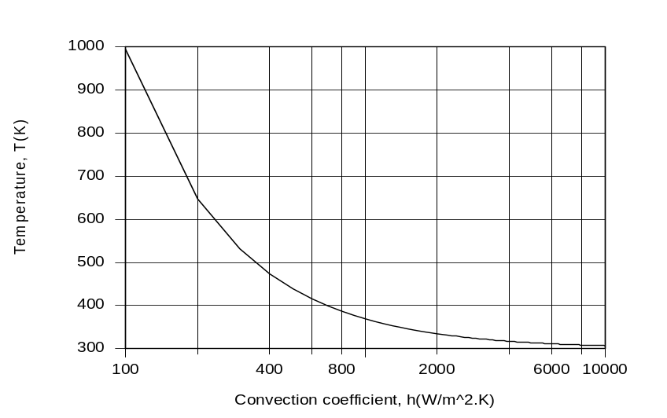
Problem Cooling of Spherical Canister

